Slide 1
The Rady School of Management
WELCOME !
MGT 103 Product Marketing & Management
Mon. & Wed. , 11:00 a.m. – 12:20 p.m.
OTRSN 1S114
Professor Burt De Mill

Slide 2
GROUND RULES
Have Fun ! (Marketing is fun…but I’m biased)
Be in Class – Marketing is a contact sport
Engage – challenge yourself, your classmates, AND the Professor
Laptops are for note taking, NOT Instagram & Facebook
Be respectful, constructive

Slide 3
Your MGT 103 Goals?
What would you like to get from MGT 103?
What are your favorite companies, brands?

Slide 4
Key Topics for Today - Lecture #1
Define marketing and identify the diverse factors influencing marketing actions.
Explain how marketing discovers and satisfies consumer needs.
Distinguish between marketing mix factors and environmental forces.
Explain how organizations build strong customer relationships and customer value through marketing.
Describe how today’s customer relationship era differs from prior eras.

Slide 5

WHAT IS MARKETING? (1 of 2)
What Is Marketing?
You Are a Marketing Expert Already
Involved in Thousands of Buying Decisions
Involved in Some Selling Decisions
Marketing Is NOT Easy
Many try, few excel!
©Patrick T. Fallon/Bloomberg via Getty Images

Slide 6
FIGURE 1-1 The see-if-you’re-really-a-marketing-expert test
What is the name of Pepsi’s most recent entry into the mid-calorie market for cola flavored soft drinks? (a) Pepsi XL, (b) Pepsi Edge (c) Pepsi Next, (d) Pepsi True.
True or False. The 60-year lifetime value of a loyal Kleenex customer is $994.
To be socially responsible, Patagonia recycles which of the following to produce many of its products? (a) tires, (b) paper, (c) plastic bottles.

Slide 7
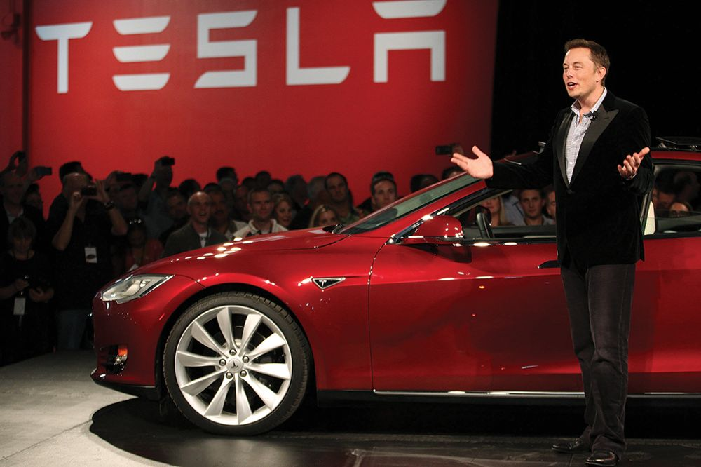
WHAT IS MARKETING? (2 of 2)
Marketing and Your Career
Goal is to “Do Marketing!”
Small Businesses Offer Marketing Careers
You Too Could Start a Successful Business!
©Reuters/Alamy Stock Photo

Slide 8
WHAT IS MARKETING? DELIVERING VALUE TO CUSTOMERS
Marketing
Seeks to:
Discover Needs and Wants of Customers
Satisfy Them
Exchange

Slide 9
WHAT IS MARKETING? REQUIREMENTS FOR MARKETING TO OCCUR
Two+ Parties with Unsatisfied Needs
A Desire and Ability to Be Satisfied
A Way for the Parties to Communicate
Something to Exchange

Slide 10
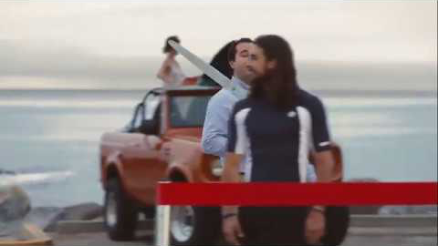
WHAT IS MARKETING? REQUIREMENTS FOR MARKETING TO OCCUR

Slide 11
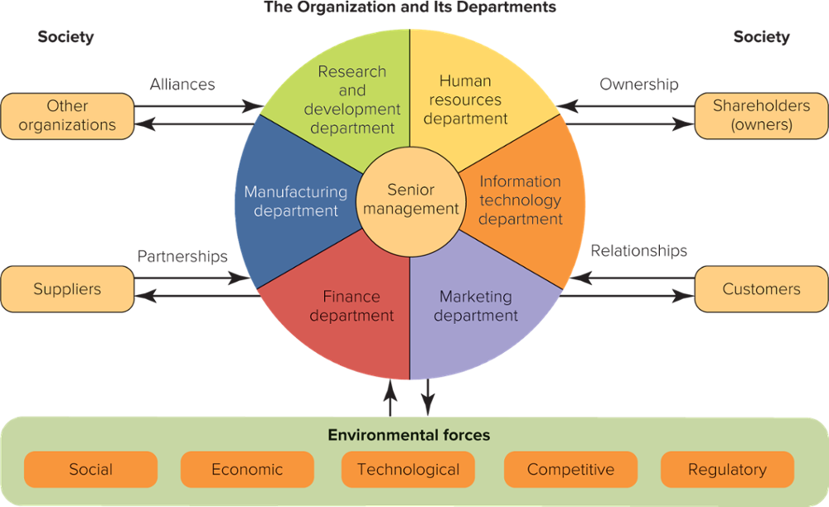
FIGURE 1-2 A marketing department relates to many people, organizations, and environmental forces.

Slide 12
HOW MARKETING DISCOVERS CONSUMER NEEDS THE CHALLENGE: NEW PRODUCTS
Consumers May Not Know or Cannot Describe What They Need or Want
Most New Products Fail
The Challenge:
“Focus on the Consumer Benefit”
“Learn From Past Mistakes”

Slide 13
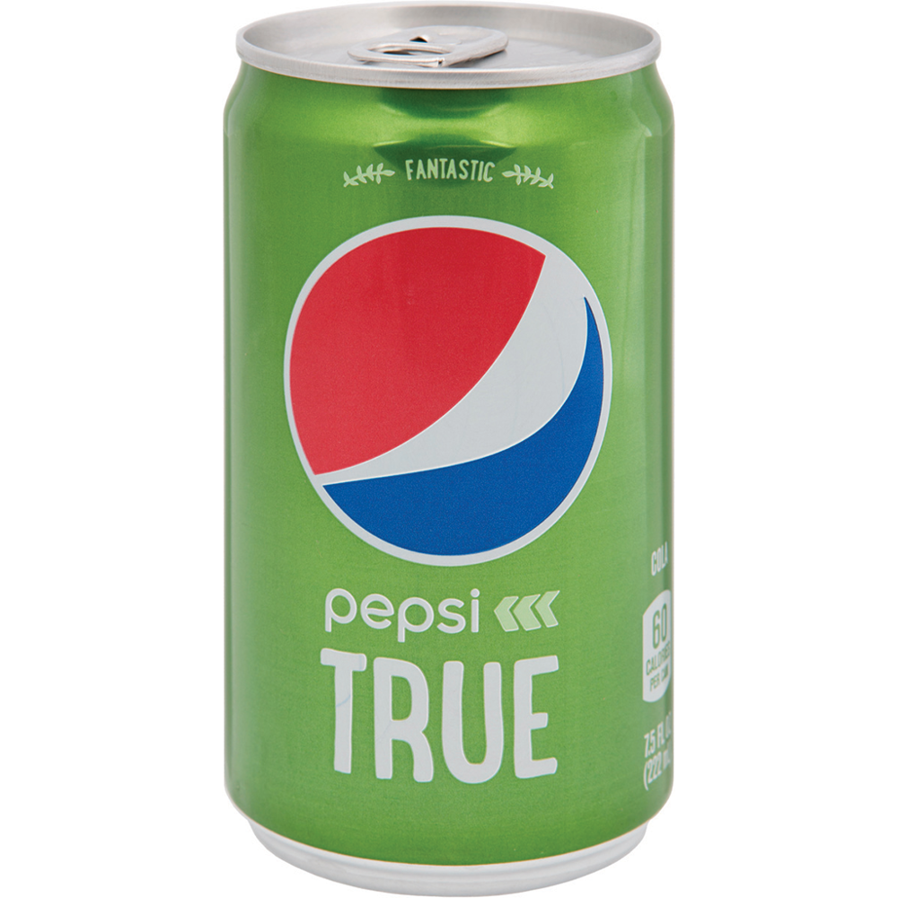

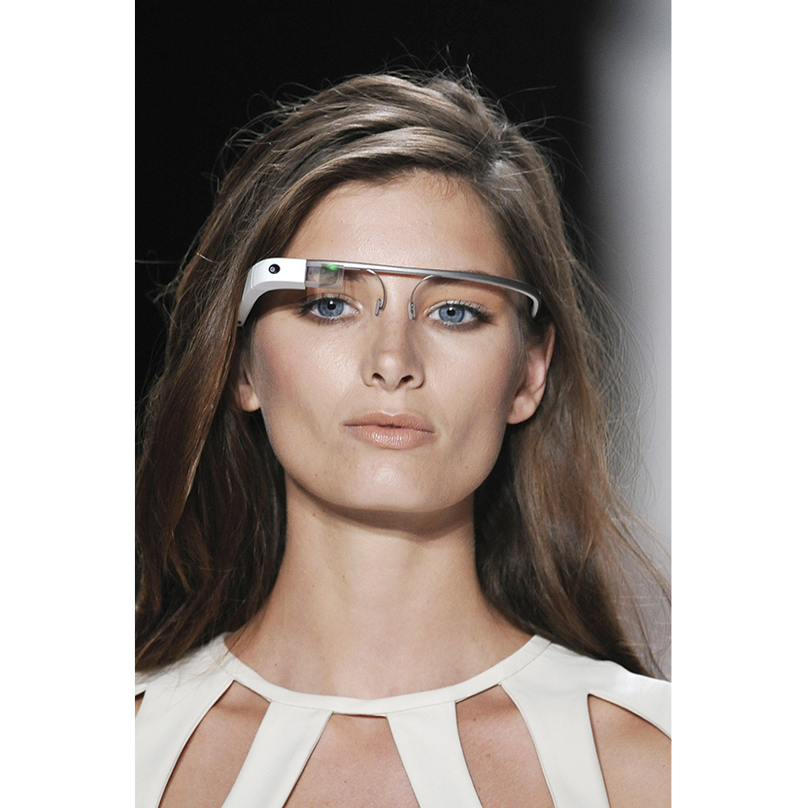
Wearable Computer? What “benefits” and what “showstoppers”?
Mid-Calorie Soda
Automobile
Subscription
Service
Wearable Computer
Pepsi True Ad
Volvo
Google Glass
Top: ©Victor Virgile/Gamma-Rapho via Getty Images; Bottom: ©Consumer Trends/Alamy Stock Photo

Slide 14

Google Glass winner or loser?

Slide 15
HOW MARKETING DISCOVERS CONSUMER NEEDS NEEDS vs. WANTS
Needs
Wants
Does Marketing Persuade People to Buy the “wrong” things?

Slide 16
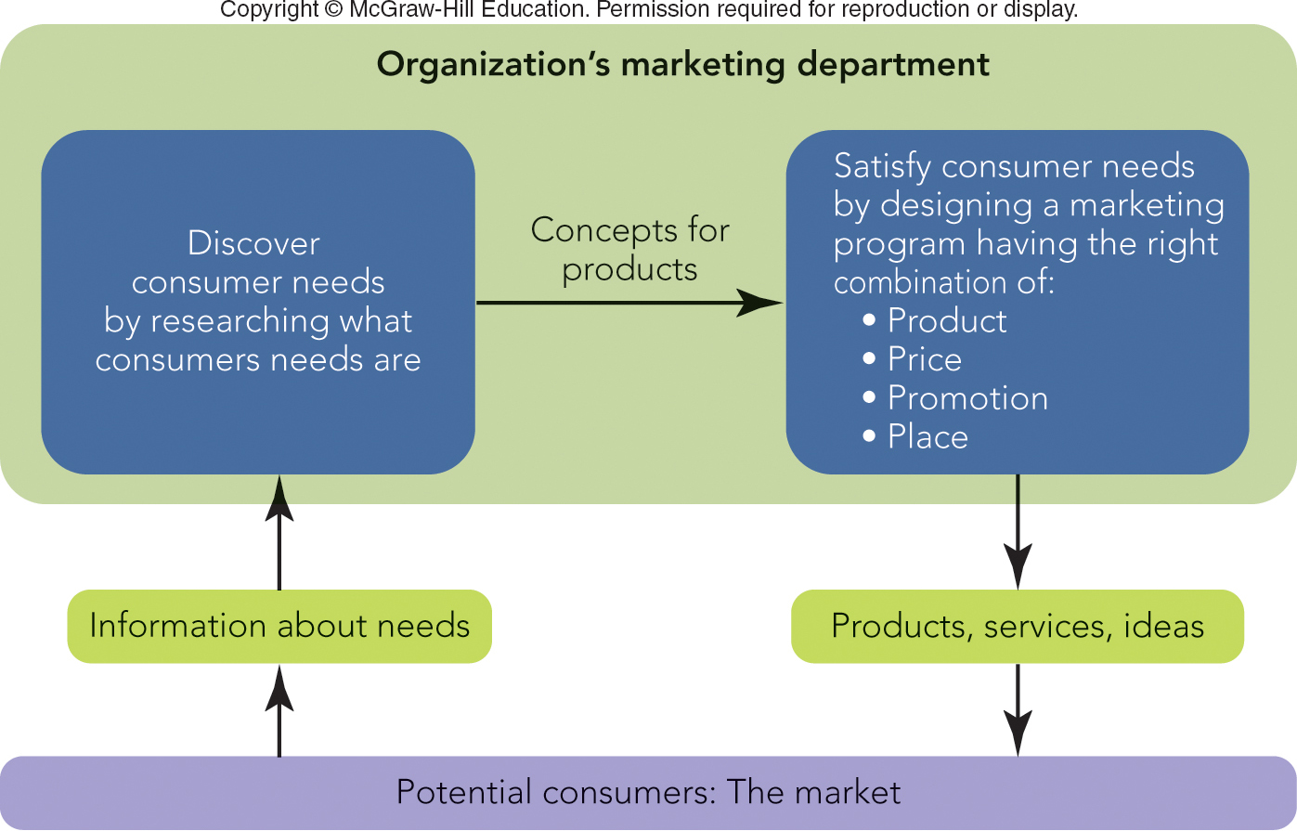
FIGURE 1-3 Marketing seeks to discover consumer needs through research and then satisfy them with a marketing program.

Slide 17
HOW MARKETING SATISFIES CONSUMER NEEDS THE FOUR Ps
Target Market
The 4 Ps:
Controllable Marketing Mix Factors
Product
Promotion
Price
Place

Slide 18

HOW MARKETING DISCOVERS CONSUMER NEEDS ENVIRONMENTAL FORCES
Customer Value Proposition
Uncontrollable Environmental Forces
Social
Competitive
Economic
Regulatory
Technological
©Luke MacGregor/Bloomberg via Getty Images

Slide 19
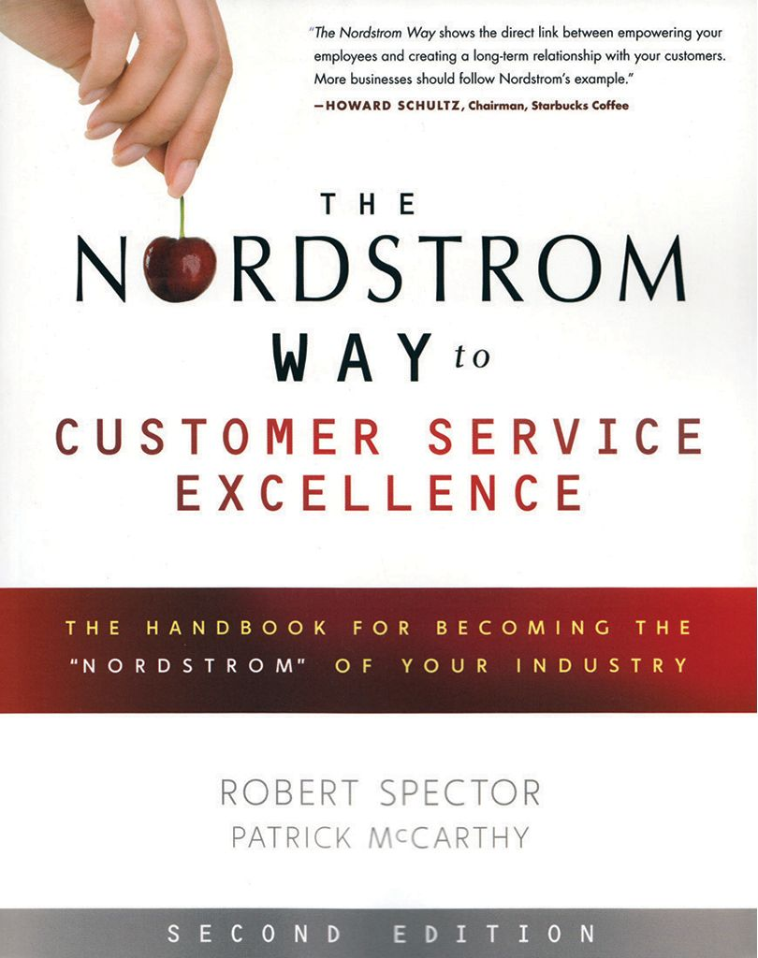
THE MARKETING PROGRAM HOW CUSTOMER RELATIONSHIPS ARE BUILT
Customer Value
Customer Value Strategies
Best Price: Target
Best Service: Nordstrom
Best Product: Starbucks
©Studio Works/Alamy Stock Photo

Slide 20
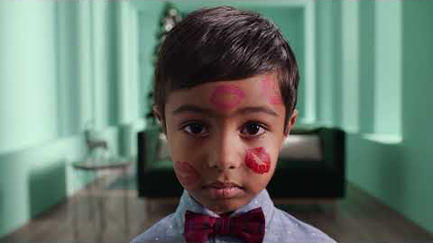
What is their message? Target audience? Value?

Slide 21
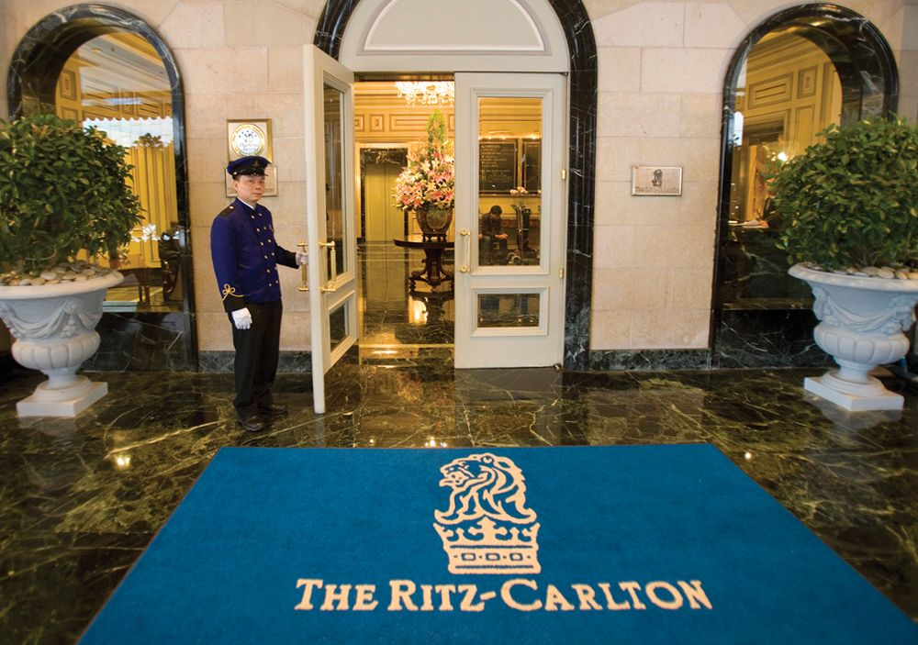
THE MARKETING PROGRAM RELATIONSHIP MARKETING
Relationship Marketing
Easy to Understand
Hard to Do
Marketing Program
Market Segments
©Paul Hilton/Bloomberg via Getty Images

Slide 22
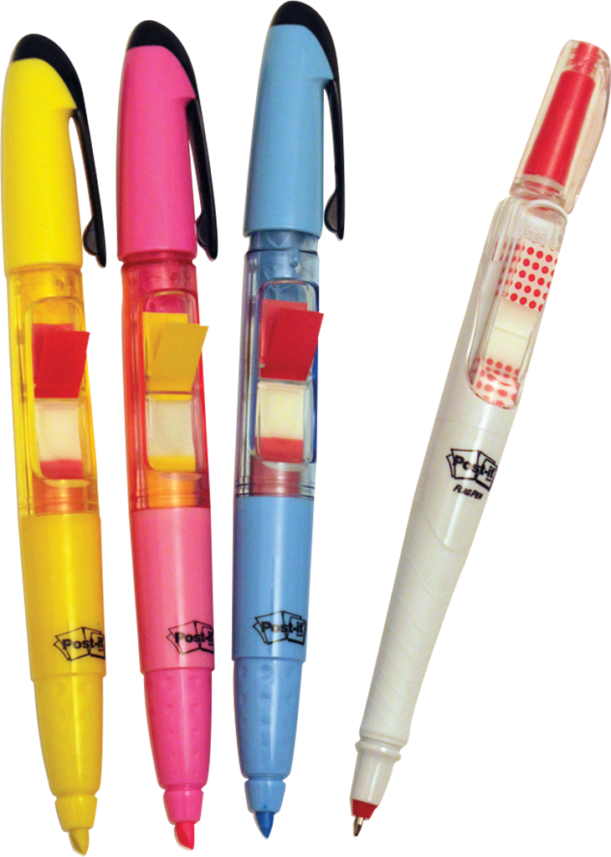
3M’S STRATEGY AND MARKETING PROGRAM DISCOVERING AND SATISFYING STUDENT STUDY NEEDS (1 of 2)
Move from Ideas to a Marketable Highlighter Product
Add the Post-it® Flag Pen
Develop a Marketing Program for the Post-it® Flag Highlighter and Pen
3M Post-it Flag Highlighter
©McGraw-Hill Education/Mike Hruby, photographer

Slide 23
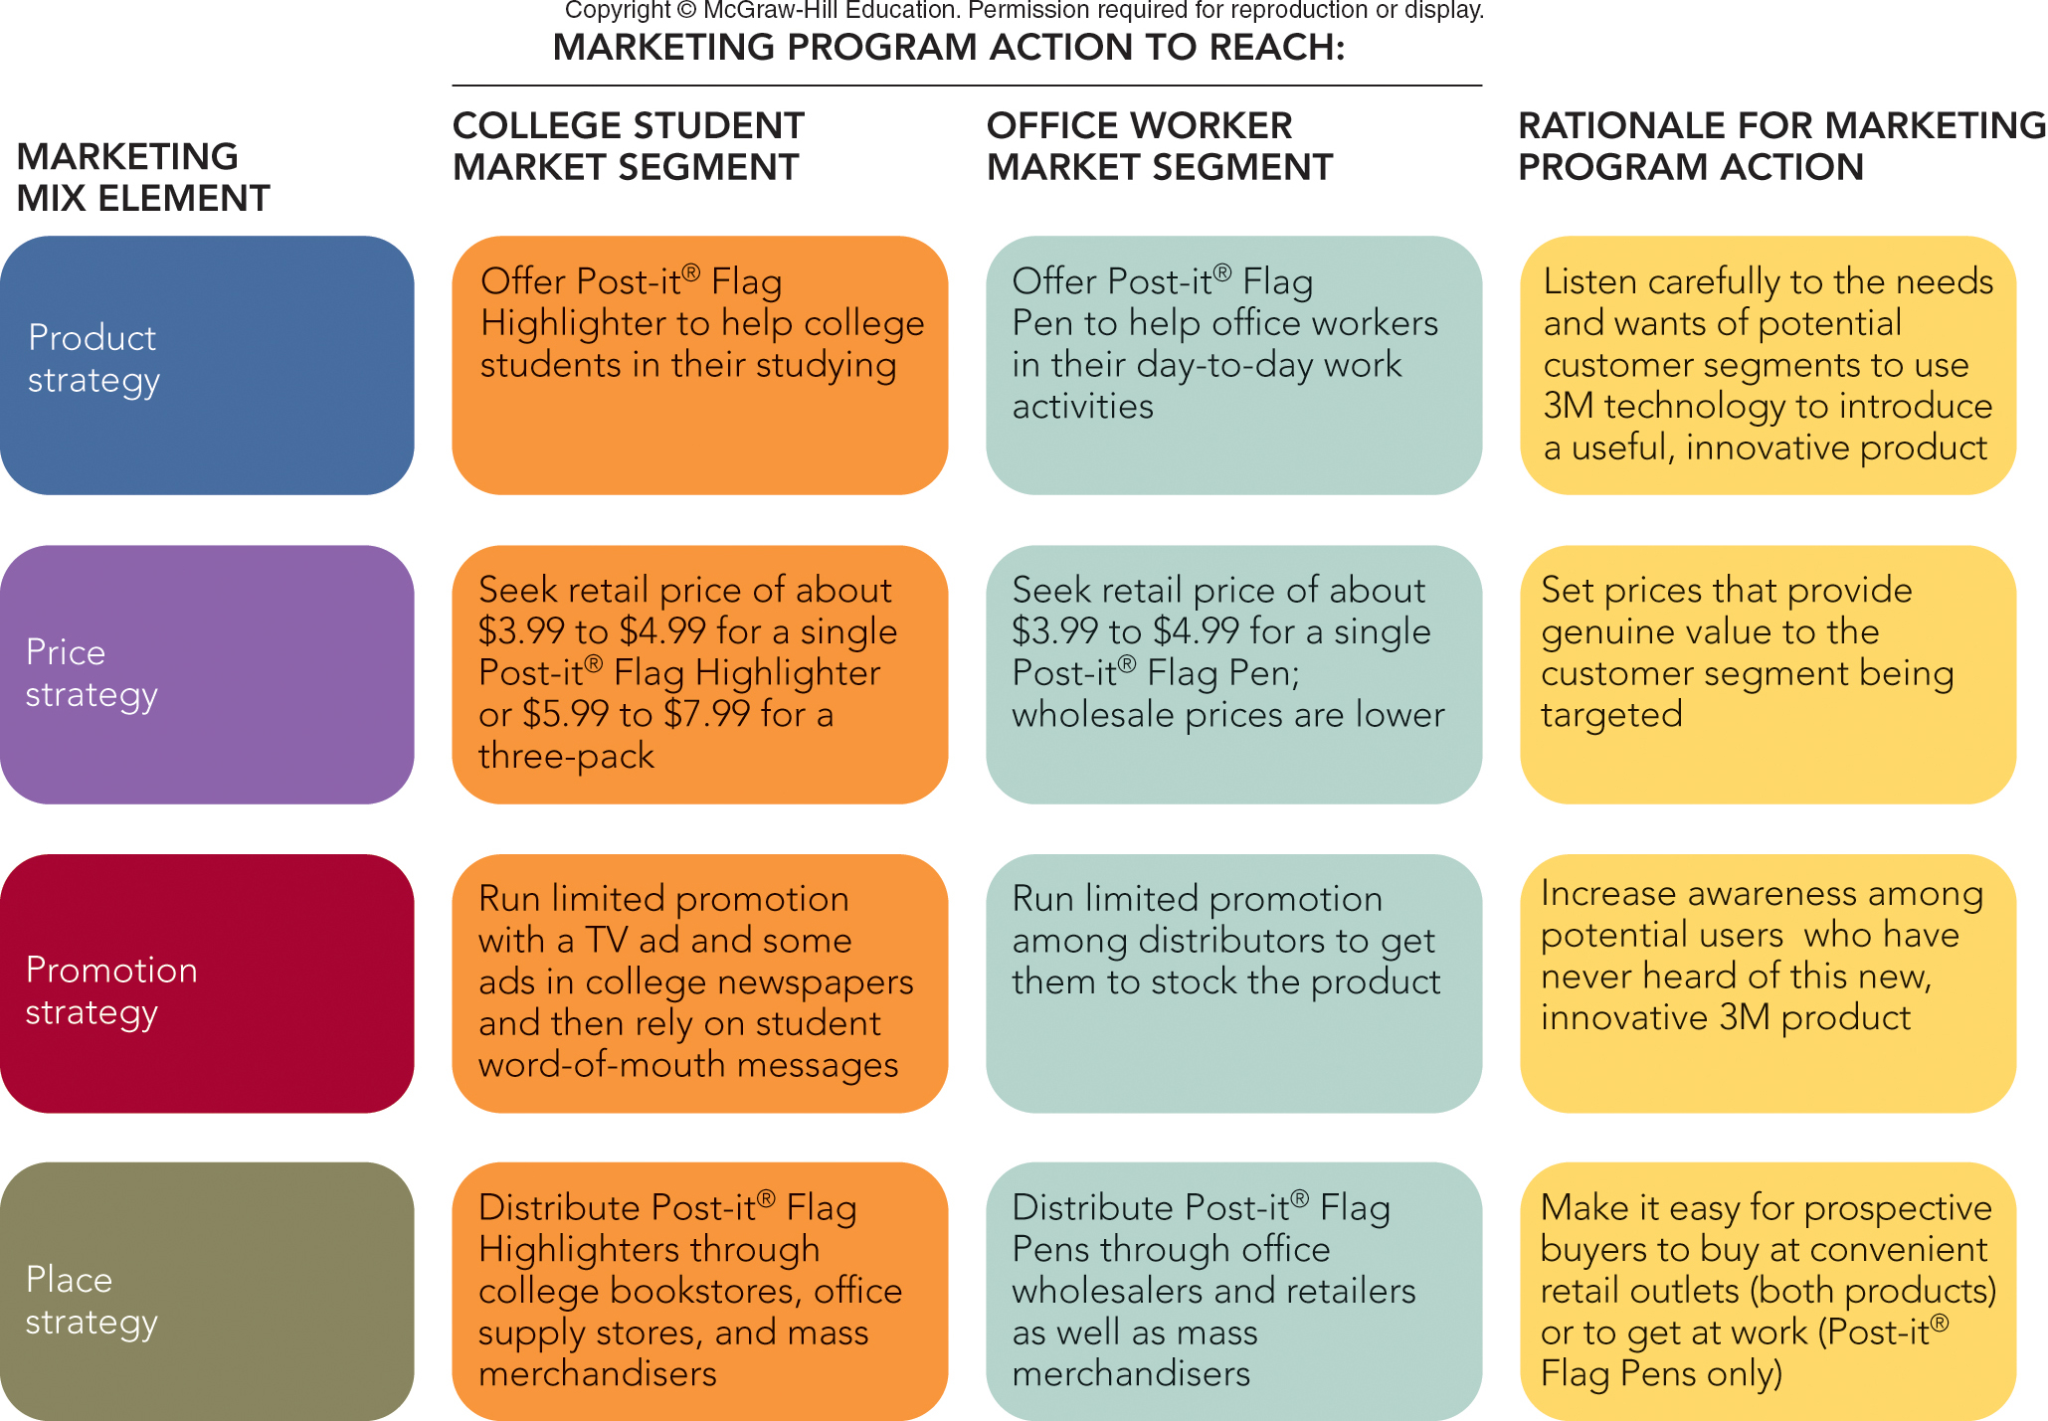
FIGURE 1-4 Marketing programs for two new 3M Post-it® brand products targeted at college students and office workers.

Slide 24
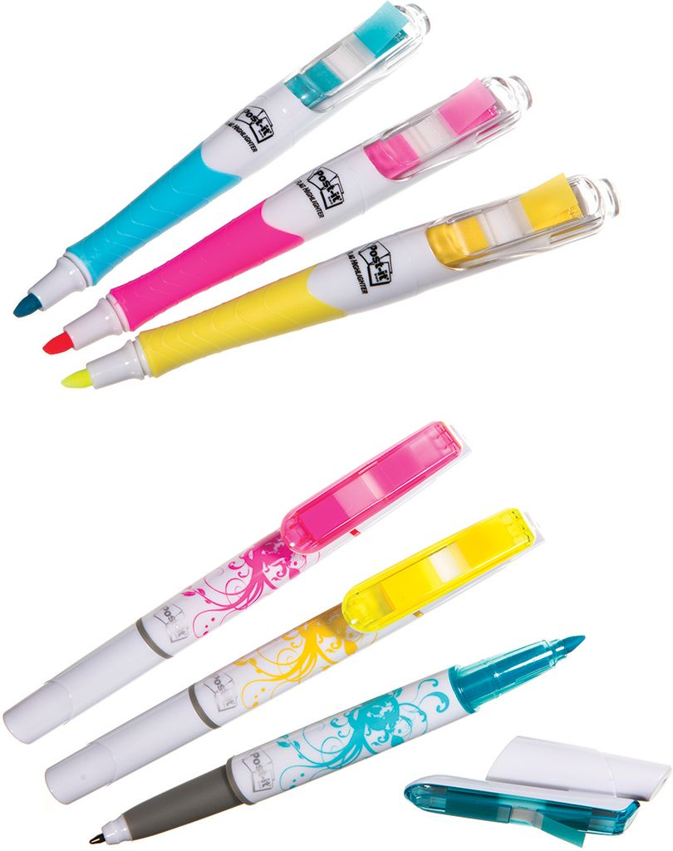
3M’S STRATEGY AND MARKETING PROGRAM DISCOVERING AND SATISFYING STUDENT STUDY NEEDS (2 of 2)
Developed Third-Generation Post-it® Flag Highlighter
Appeared on The Oprah Winfrey Show

Slide 25
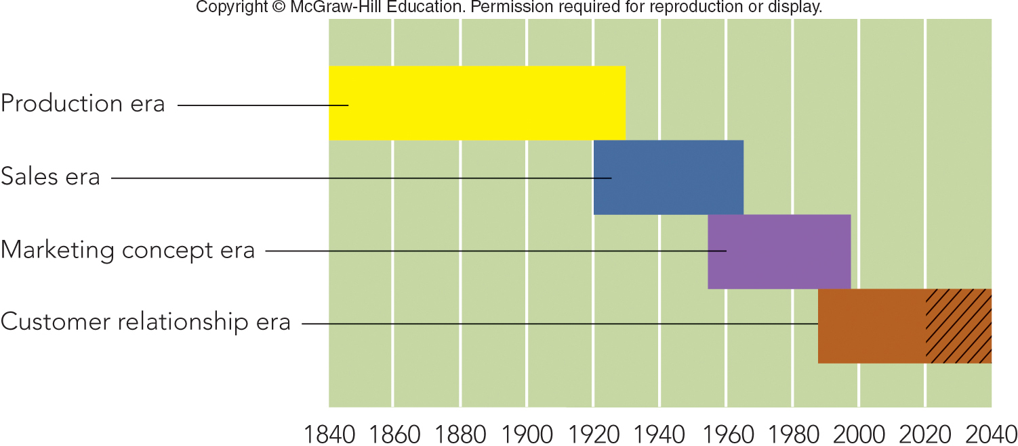
FIGURE 1-5 Four different orientations in the history of American business

Slide 26
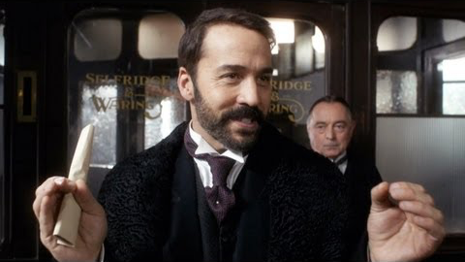
Selfridge’s

Slide 27
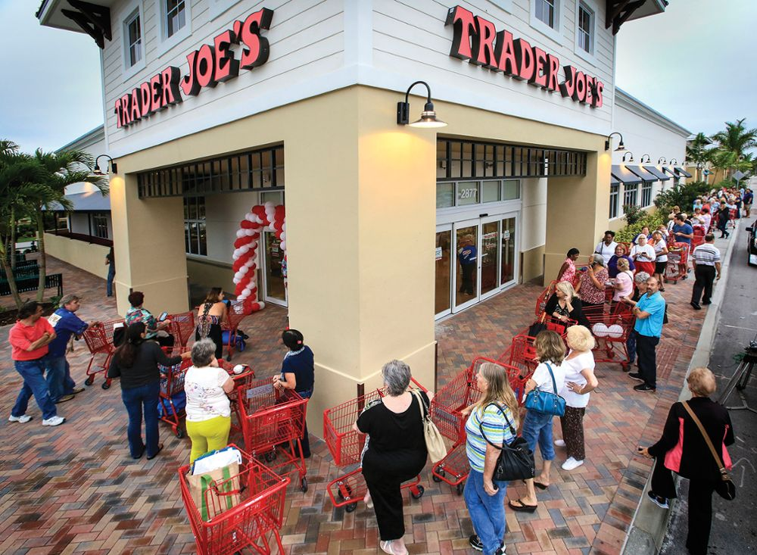
HOW MARKETING BECAME IMPORTANT EVOLUTION OF THE MARKET ORIENTATION
Market Orientation
Customer Relationship Management (CRM)
Customer Experience
What Firms Think They Offer Customers
What Customers Say They Receive
©Lannis Waters/ZUMA Press/Newscom

Slide 28
HOW MARKETING BECAME IMPORTANT ETHICS AND SOCIAL RESPONSIBILITY
Ethics–Companies develop codes of ethics
Social Responsibility– Organizations are accountable to a larger society
Societal Marketing Concept

Slide 29

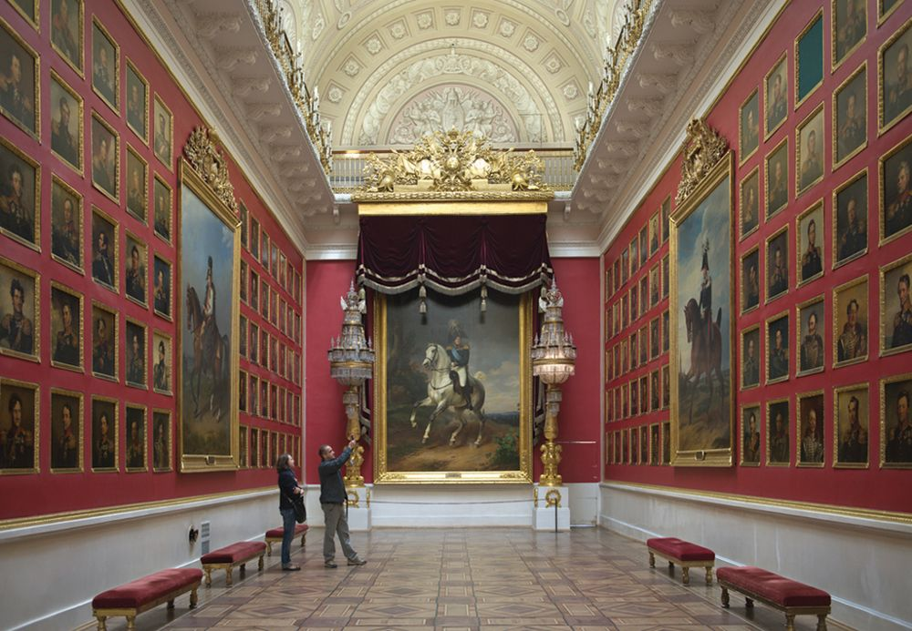
HOW MARKETING BECAME IMPORTANT BREADTH AND DEPTH OF MARKETING (1 of 2)
Who Markets?
What Is Marketed?
Products (Goods)
Services
Ideas
Hermitage Tour
Top: ©AFP/Getty Images; Bottom: ©Izzet Keribar/Lonely Plant Images/Getty Images

Slide 30

HOW MARKETING BECAME IMPORTANT BREADTH AND DEPTH OF MARKETING (2 of 2)
Who Buys and Uses What Is Marketed?
Ultimate Consumers
Organizational Buyers
Who Benefits?
How Consumers Benefit: Utility
Form Utility
Place Utility
Time Utility
Possession Utility
©Source: Peace Corps

Slide 31
IN-CLASS ACTIVITY 1-1
DESIGNING A CANDY BAR

Slide 32
Designing a Better Candy Bar
Designing a Better Candy Bar
Example: Ghirardelli Chocolate
Ghirardelli
Website
Ghirardelli Ad

Slide 33
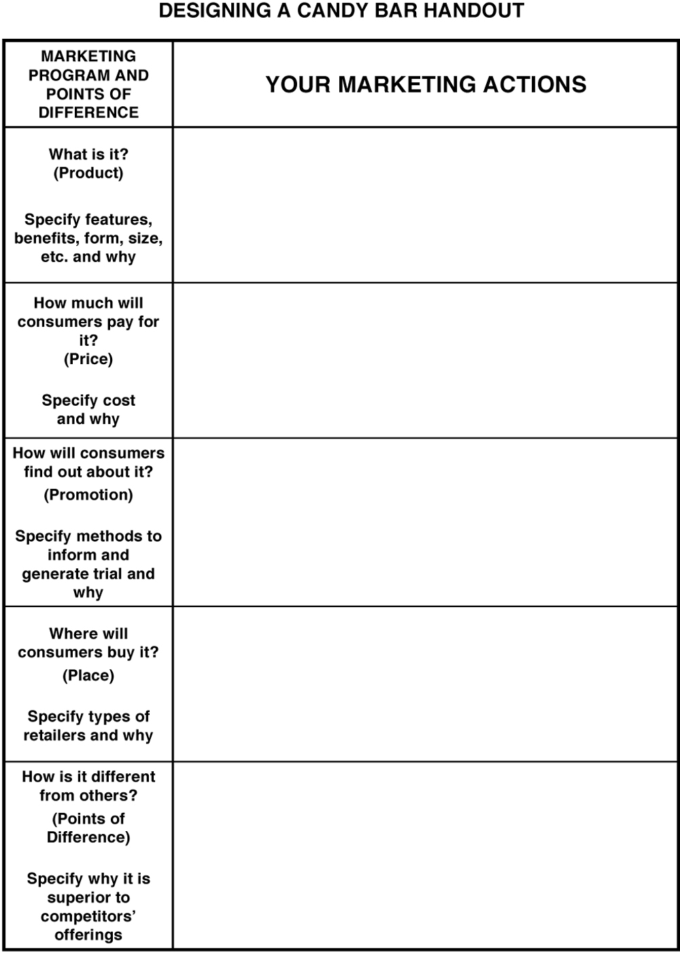
Candy Bar Handout

Slide 34
Assignments for Wednesday……..
Textbook Reading, Chapter 2 and Appendix A
Appendix A will be our model for Group Project later in the quarter
Office Hours – Mondays 1:30 p.m. – 3:30 p.m. Rady Undergrad Offices, 2E108
Visit http://www.selfridges.com/US/en/ to prepare for in class exercise

Slide 35
The Rady School of Management
MGT 103 Product Marketing & Management
Mon. & Wed. , 11:00 a.m. – 12:20 p.m.
OTRSN 1S114
Professor Burt De Mill

